Slide 1

CHAPTER 10
GRAPHS AND TREES
Copyright © Cengage Learning. All rights reserved.

Slide 2
SECTION 10.1
Graphs: Definitions and Basic Properties
Copyright © Cengage Learning. All rights reserved.

Slide 3
Graphs: Definitions and Basic Properties
Imagine an organization that wants to set up teams of three to work on some projects.
In order to maximize the number of people on each team who had previous experience working together successfully, the director asked the members to provide names of their past partners.

Slide 4
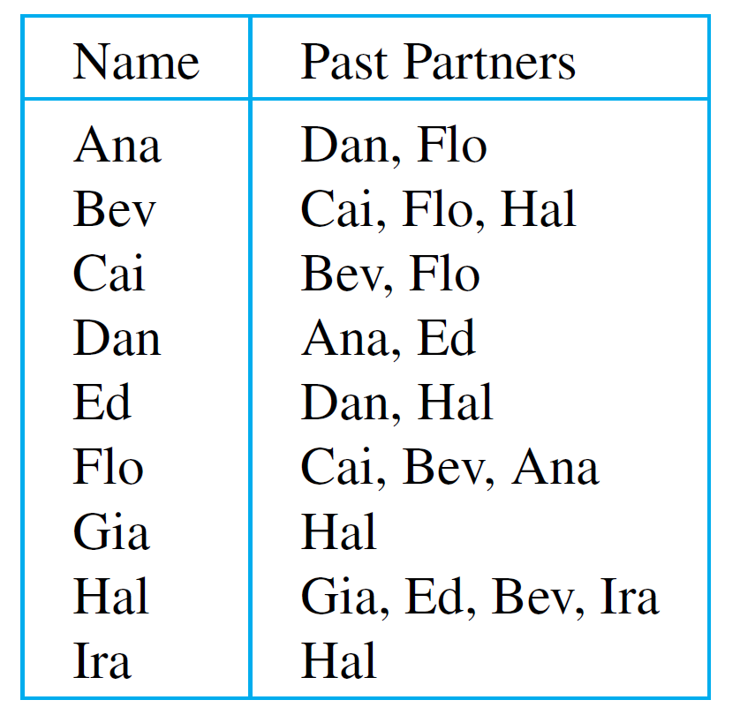
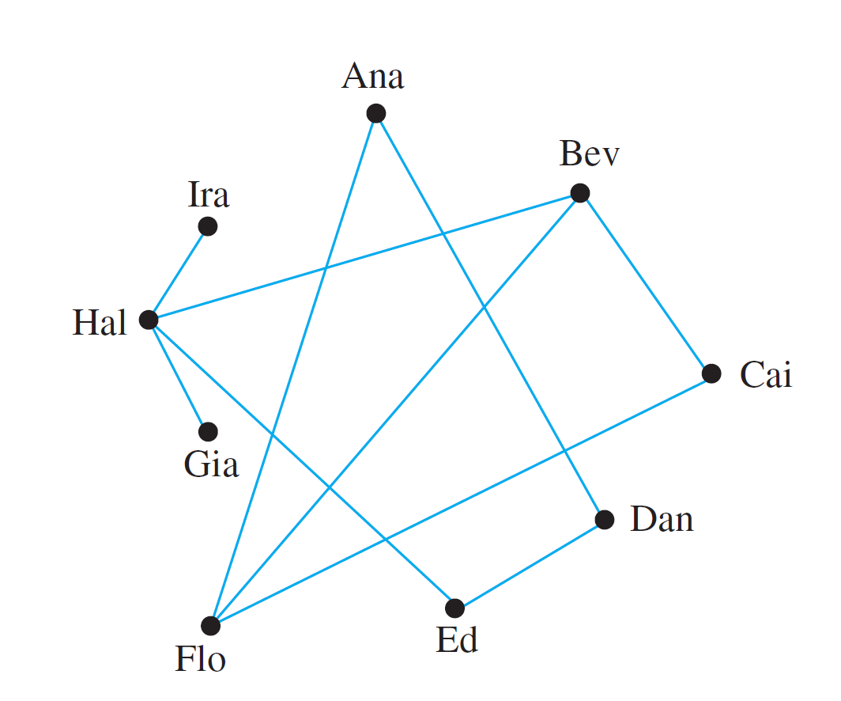
Graphs: Definitions and Basic Properties
This information is displayed below both in a table and in a diagram.

Slide 5
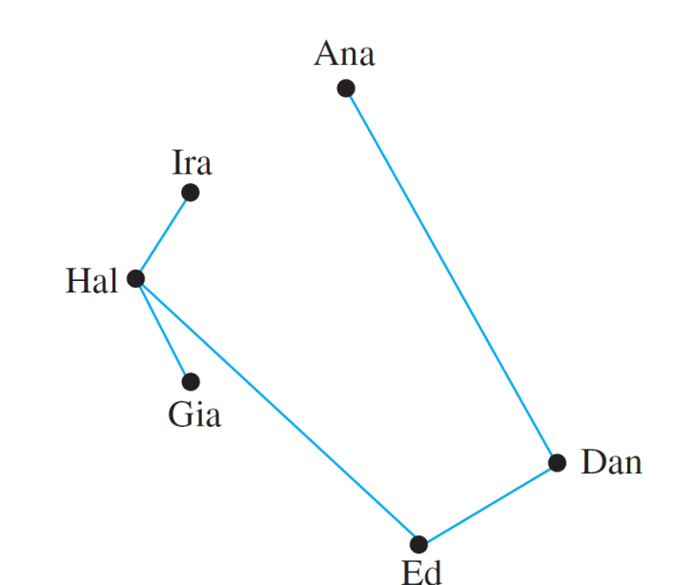
Graphs: Definitions and Basic Properties
From the diagram, it is easy to see that Bev, Cai, and Flo are a group of three past partners, and so they should form one of these teams.
The following figure shows the result when these three names are removed from the diagram.

Slide 6
Graphs: Definitions and Basic Properties
This drawing shows that placing Hal on the same team as Ed would leave Gia and Ira on a team containing no past partners.
However, if Hal is placed on a team with Gia and Ira, then the remaining team would consist of Ana, Dan, and Ed, and both teams would contain at least one pair of past partners.
Drawings such as those shown previously are illustrations of a structure known as a graph.
The dots are called vertices (plural of vertex) and the line segments joining vertices are called edges.

Slide 7
Graphs: Definitions and Basic Properties
As you can see from the drawing, it is possible for two edges to cross at a point that is not a vertex. Note also that the type of graph described here is quite different from the “graph of an equation” or the “graph of a function.”
In general, a graph consists of a set of vertices and a set of edges connecting various pairs of vertices.

Slide 8
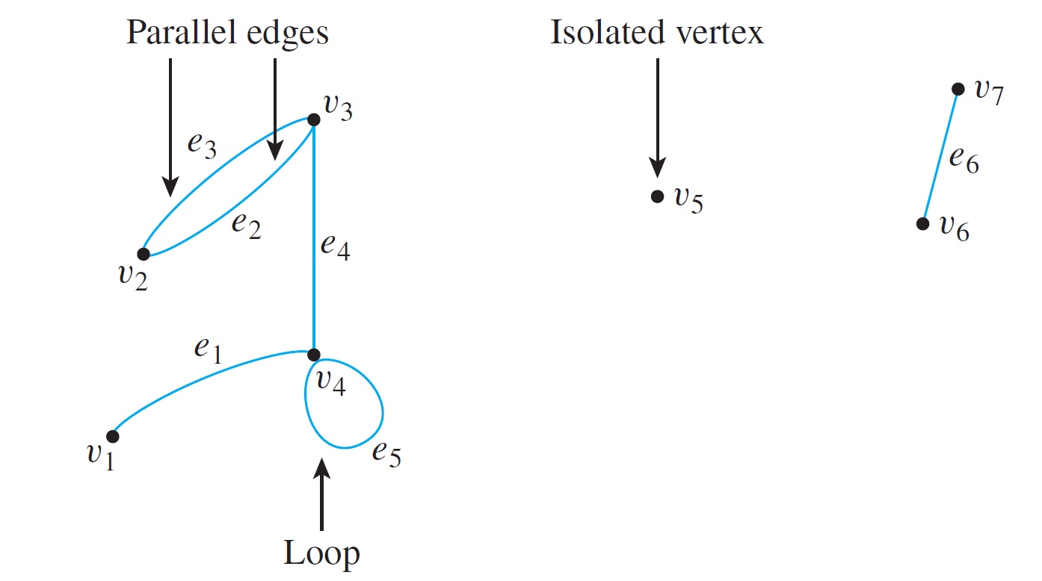
Graphs: Definitions and Basic Properties
The edges may be straight or curved and should either connect one vertex to another or a vertex to itself, as shown below.

Slide 9
Graphs: Definitions and Basic Properties
In this drawing, the vertices have been labeled with v ’s and the edges with e’s.
When an edge connects a vertex to itself (as e₅ does), it is called a loop. When two edges connect the same pair of vertices (as e₂ and e₃ do), they are said to be parallel.
It is quite possible for a vertex to be unconnected by an
edge to any other vertex in the graph (as v₅ is), and in that case the vertex is said to be isolated.

Slide 10
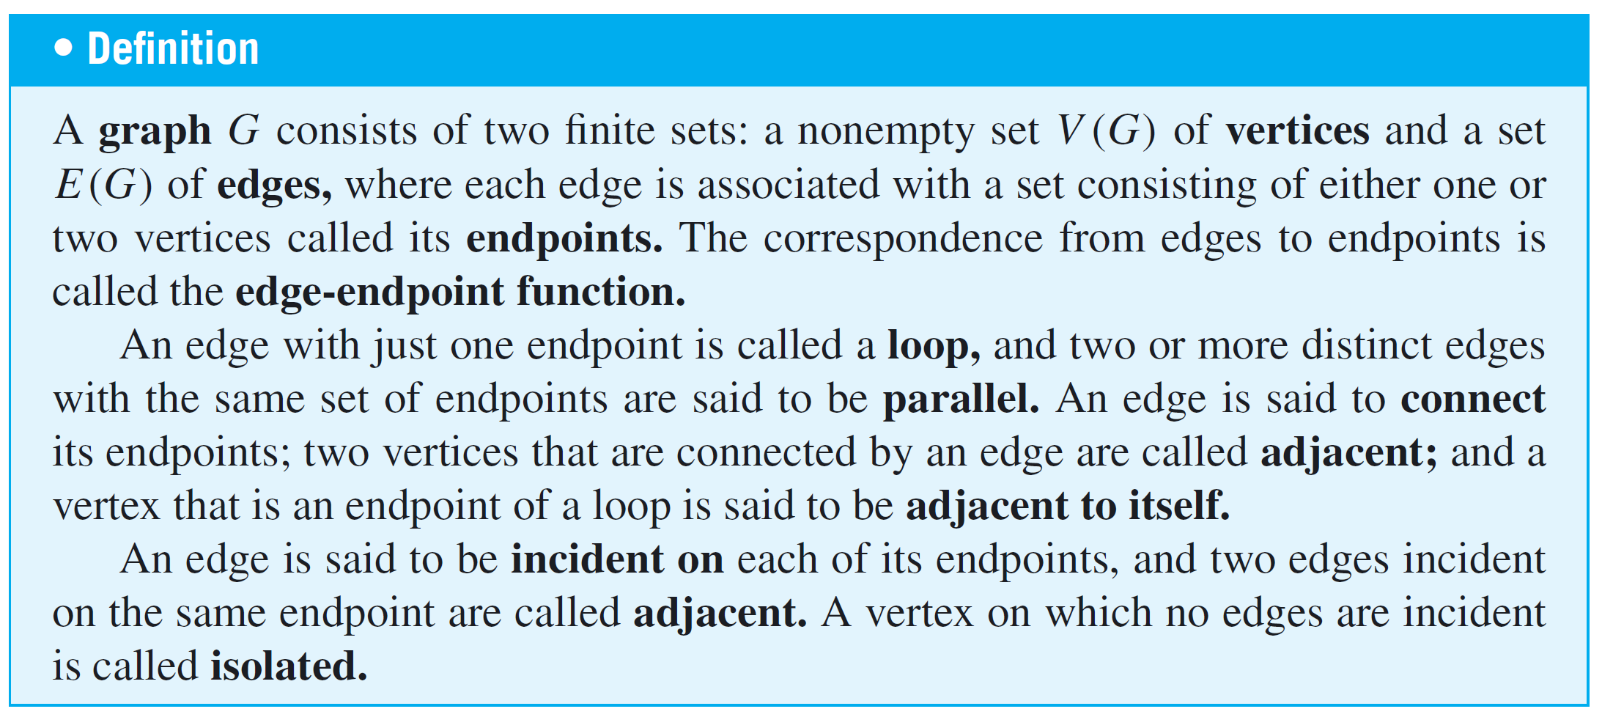
Graphs: Definitions and Basic Properties
The formal definition of a graph follows.

Slide 11
Graphs: Definitions and Basic Properties
Graphs have pictorial representations in which the vertices are represented by dots and the edges by line segments.
A given pictorial representation uniquely determines a graph.

Slide 12
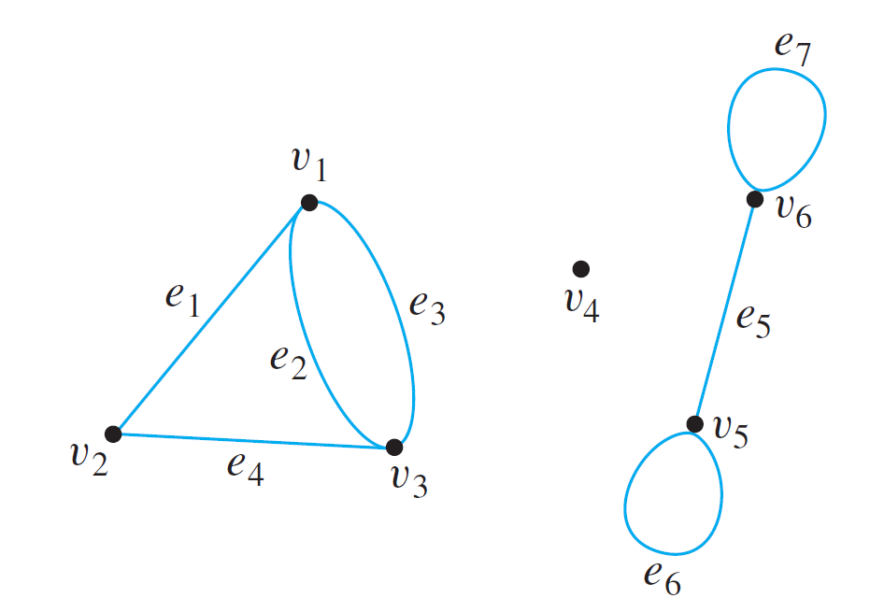
Example 1 – Terminology
Consider the following graph:
a. Write the vertex set and the edge set, and give a table
showing the edge-endpoint function.
b. Find all edges that are incident on v₁, all vertices that
are adjacent to v₁, all edges that are adjacent to e₁, all
loops, all parallel edges, all vertices that are adjacent to
themselves, and all isolated vertices.

Slide 13
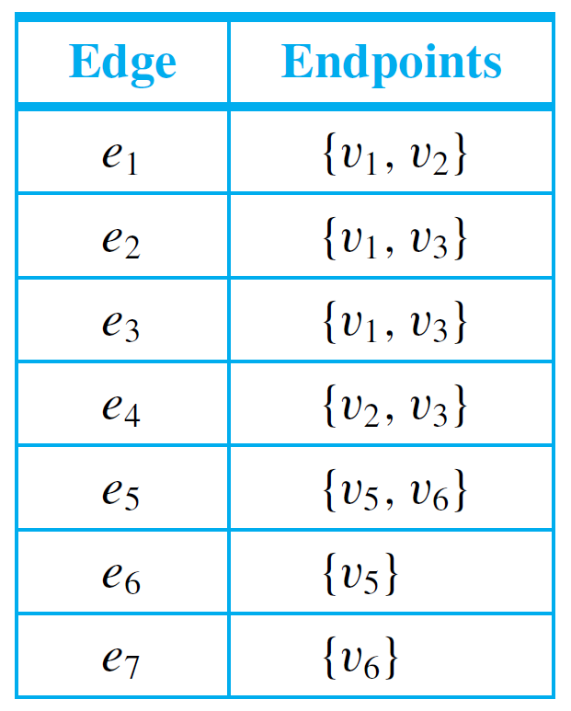
Example 1(a) – Solution
vertex set = {v₁, v₂, v₃, v₄, v₅, v₆}
edge set = {e₁, e₂, e₃, e₄, e₅, e₆, e₇}
edge-endpoint function:

Slide 14
Example 1(a) – Solution
cont’d
Note that the isolated vertex v₄ does not appear in this table.
Although each edge must have either one or two endpoints, a vertex need not be an endpoint of an edge.

Slide 15
Example 1(b) – Solution
cont’d
e₁, e₂, and e₃ are incident on v₁.
v₂ and v₃ are adjacent to v₁.
e₂, e₃, and e₄ are adjacent to e₁.
e₆ and e₇ are loops.
e₂ and e₃ are parallel.
v₅ and v₆ are adjacent to themselves.
v₄ is an isolated vertex.

Slide 16
Graphs: Definitions and Basic Properties
As noted earlier, a given pictorial representation uniquely determines a graph.
However, a given graph may have more than one pictorial representation.
Such things as the lengths or curvatures of the edges and the relative position of the vertices on the page may vary from one pictorial representation to another.

Slide 17
Graphs: Definitions and Basic Properties
We have discussed the directed graph of a binary relation on a set.
The general definition of directed graph is similar to the definition of graph, except that one associates an ordered pair of vertices with each edge instead of a set of vertices.
Thus each edge of a directed graph can be drawn as an arrow going from the first vertex to the second vertex of the ordered pair.

Slide 18
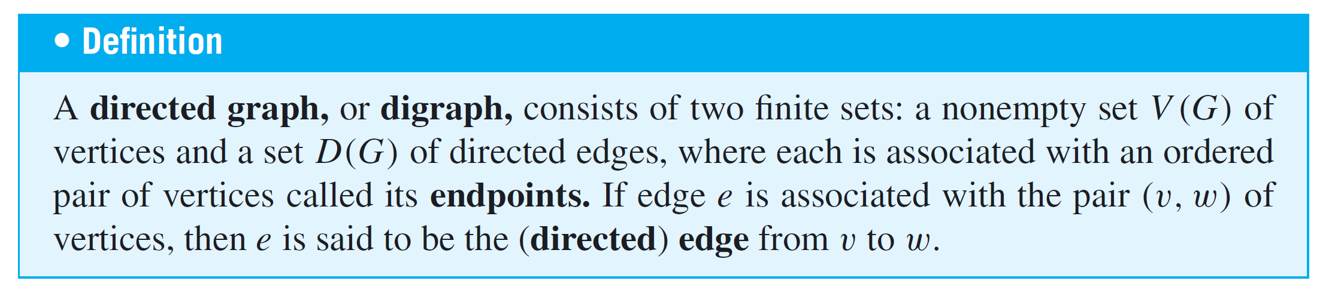
Graphs: Definitions and Basic Properties
Note that each directed graph has an associated ordinary (undirected) graph, which is obtained by ignoring the directions of the edges.

Slide 19
Examples of Graphs

Slide 20
Examples of Graphs
Graphs are a powerful problem-solving tool because they enable us to represent a complex situation with a single image that can be analyzed both visually and with the aid of a computer.

Slide 21
Example 4 – Using a Graph to Represent a Network
Telephone, electric power, gas pipeline, and air transport systems can all be represented by graphs, as can computer networks—from small local area networks to the global Internet system that connects millions of computers worldwide.
Questions that arise in the design of such systems involve choosing connecting edges to minimize cost, optimize a certain type of service, and so forth.

Slide 22
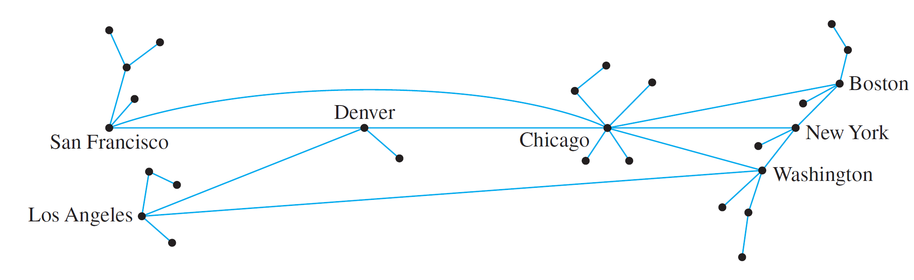
Example 4 – Using a Graph to Represent a Network
cont’d
A typical network, called a hub and spoke model, is shown below.

Slide 23
Special Graphs

Slide 24
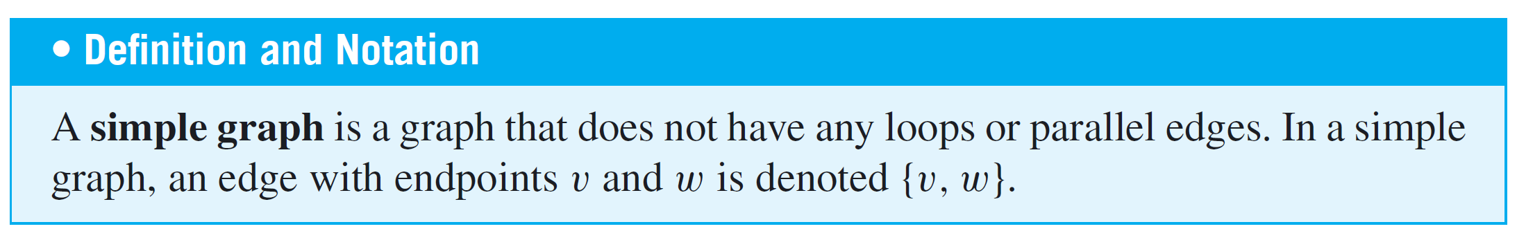
Special Graphs
One important class of graphs consists of those that do not have any loops or parallel edges.
Such graphs are called simple. In a simple graph, no two edges share the same set of endpoints, so specifying two endpoints is sufficient to determine an edge.

Slide 25

Example 8 – A Simple Graph
Draw all simple graphs with the four vertices {u, v, w, x} and two edges, one of which is {u, v}.
Solution:
Each possible edge of a simple graph corresponds to a subset of two vertices.
Given four vertices, there are = 6 such subsets in all:
{u, v}, {u, w}, {u, x}, {v, w}, {v, x}, and {w, x}.

Slide 26
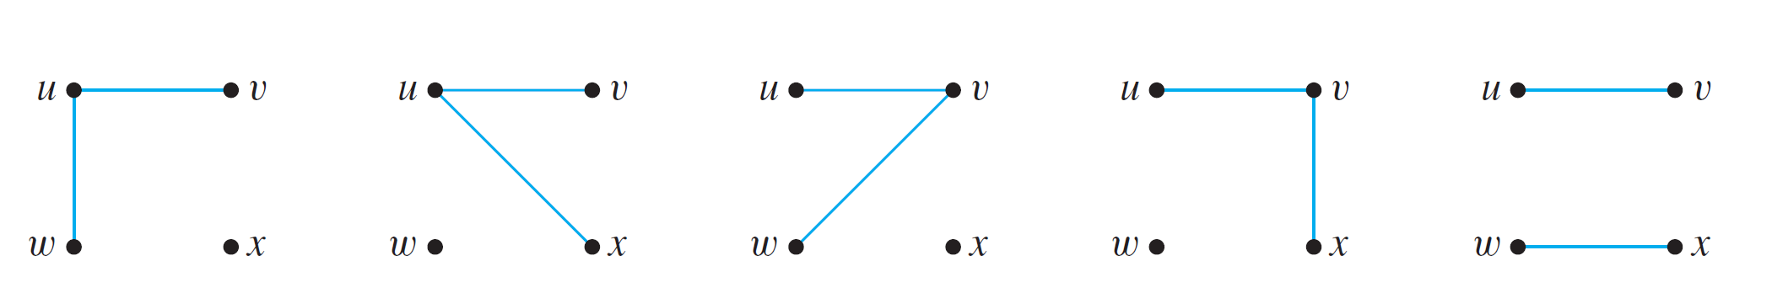
Example 8 – Solution
cont’d
Now one edge of the graph is specified to be {u, v}, so any of the remaining five from this list can be chosen to be the second edge.
The possibilities are shown below.

Slide 27
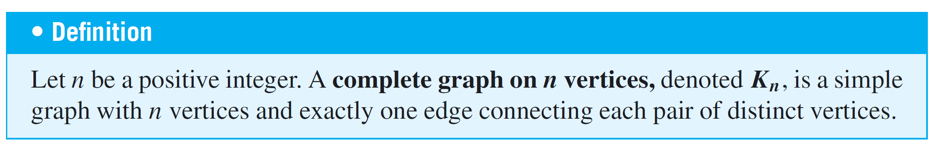
Special Graphs
Another important class of graphs consists of those that are “complete” in the sense that all pairs of vertices are connected by edges.

Slide 28
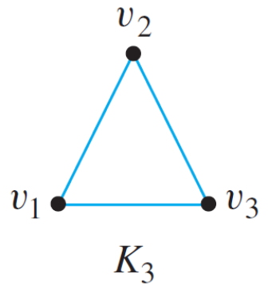
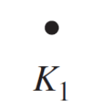
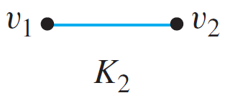
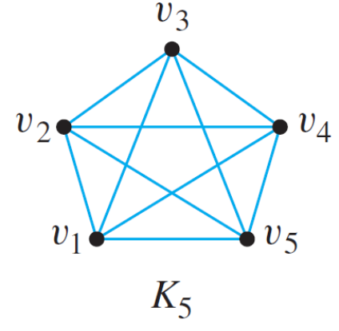
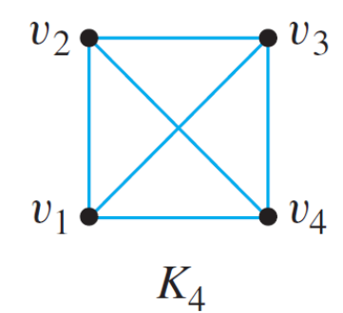
Example 9 – Complete Graphs on n Vertices: K₁, K₂, K₃, K₄, K₅
The complete graphs K₁, K₂, K₃, K₄, and K₅ can be drawn as follows:

Slide 29
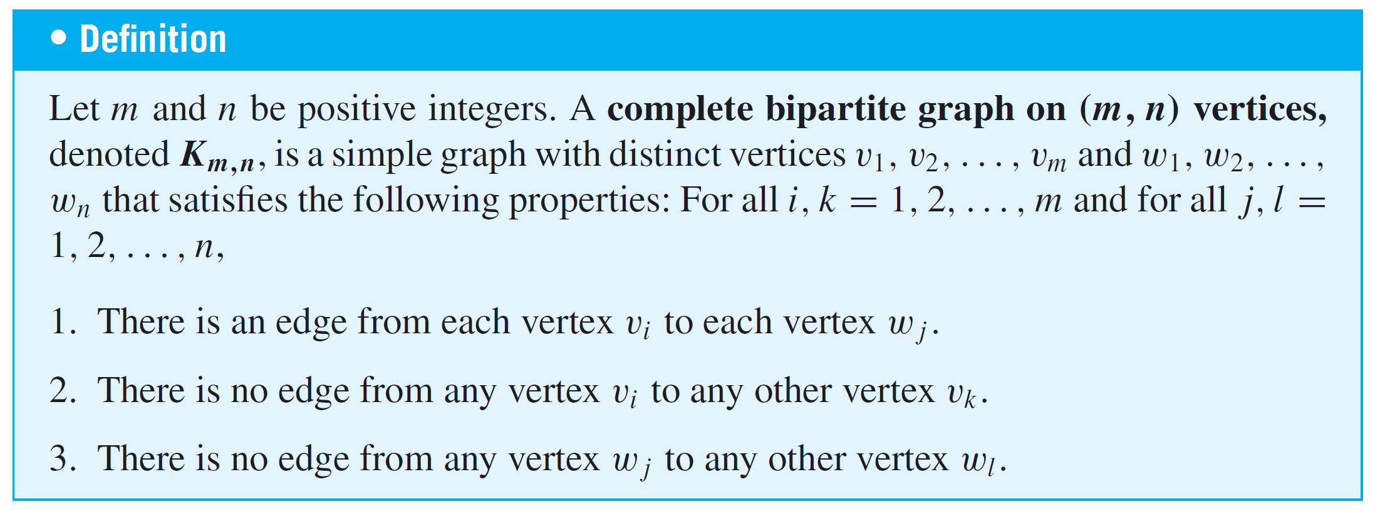
Special Graphs
In yet another class of graphs, the vertex set can be separated into two subsets: Each vertex in one of the subsets is connected by exactly one edge to each vertex in the other subset, but not to any vertices in its own subset. Such a graph is called complete bipartite.

Slide 30
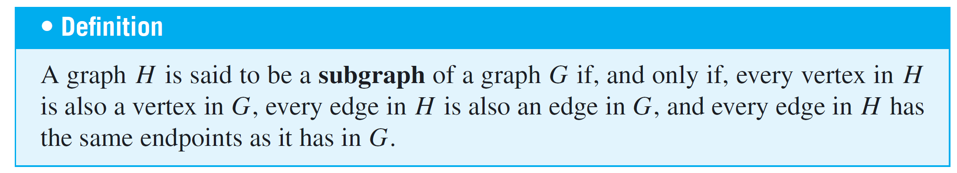
Special Graphs

Slide 31
The Concept of Degree

Slide 32
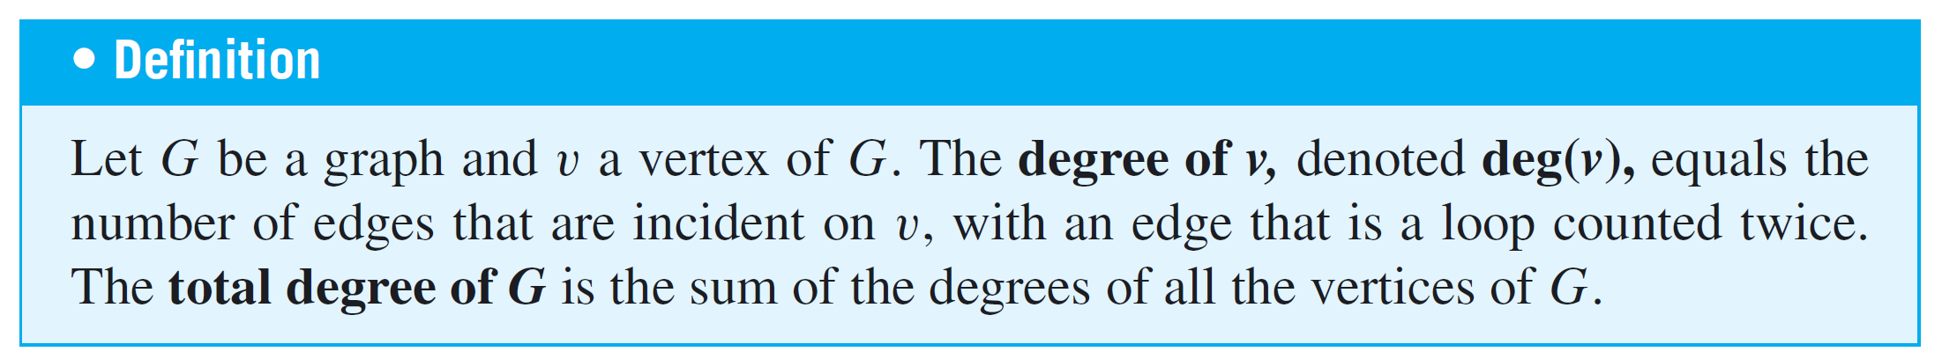
The Concept of Degree
The degree of a vertex is the number of end segments of edges that “stick out of” the vertex.
We will show that the sum of the degrees of all the vertices in a graph is twice the number of edges of the graph.

Slide 33
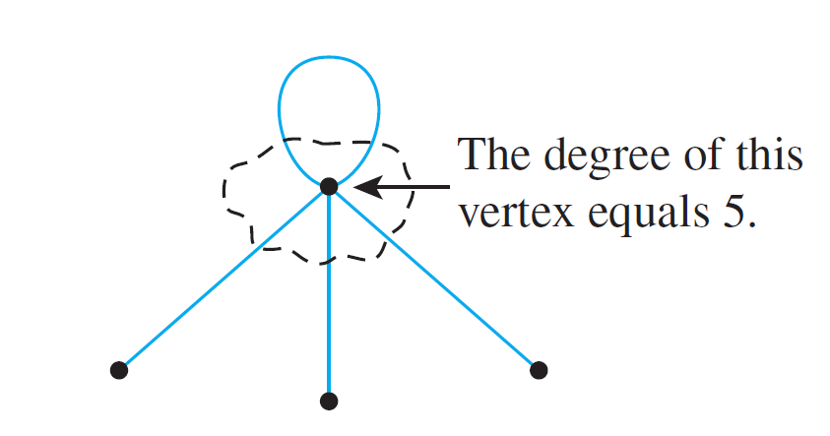
The Concept of Degree
Since an edge that is a loop is counted twice, the degree of a vertex can be obtained from the drawing of a graph by counting how many end segments of edges are incident on the vertex.
This is illustrated below.

Slide 34
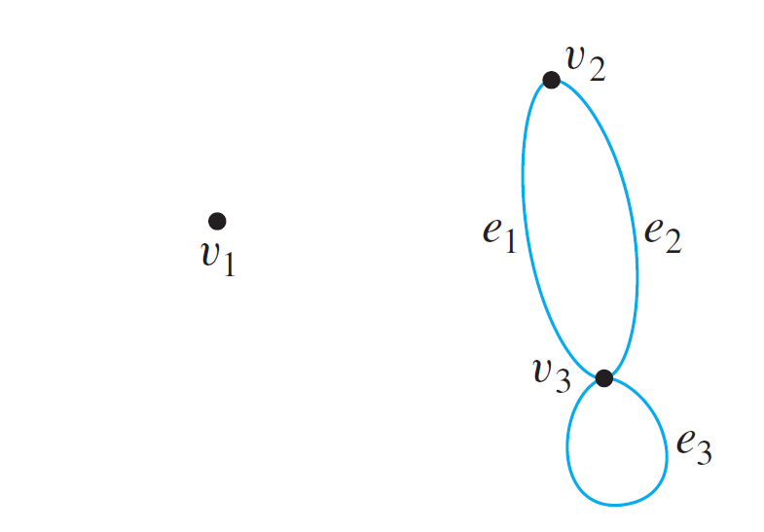
Example 12 – Degree of a Vertex and Total Degree of a Graph
Find the degree of each vertex of the graph G shown below. Then find the total degree of G.

Slide 35
Example 12 – Solution
deg(v₁) = 0 since no edge is incident on v₁ (v₁ is isolated).
deg(v₂) = 2 since both e₁ and e₂ are incident on v₂.
deg(v₃) = 4 since e₁ and e₂ are incident on v₃ and the loop e₃ is also incident on v₃ (and contributes 2 to the degree of v₃).
total degree of G = deg(v₁) + deg(v₂) + deg(v₃)
= 0 + 2 + 4
= 6.

Slide 36
The Concept of Degree
Note that the total degree of the graph G of Example 12, which is 6, equals twice the number of edges of G, which is 3.
Roughly speaking, this is true because each edge has two end segments, and each end segment is counted once toward the degree of some vertex. This result generalizes to any graph.
In fact, for any graph without loops, the general result can be explained as follows: Imagine a group of people at a party. Depending on how social they are, each person shakes hands with various other people.

Slide 37
The Concept of Degree
So each person participates in a certain number of handshakes—perhaps many, perhaps none—but because each handshake is experienced by two different people, if the numbers experienced by each person are added together, the sum will equal twice the total number of handshakes.
This is such an attractive way of understanding the situation that the following theorem is often called the handshake lemma or the handshake theorem.

Slide 38
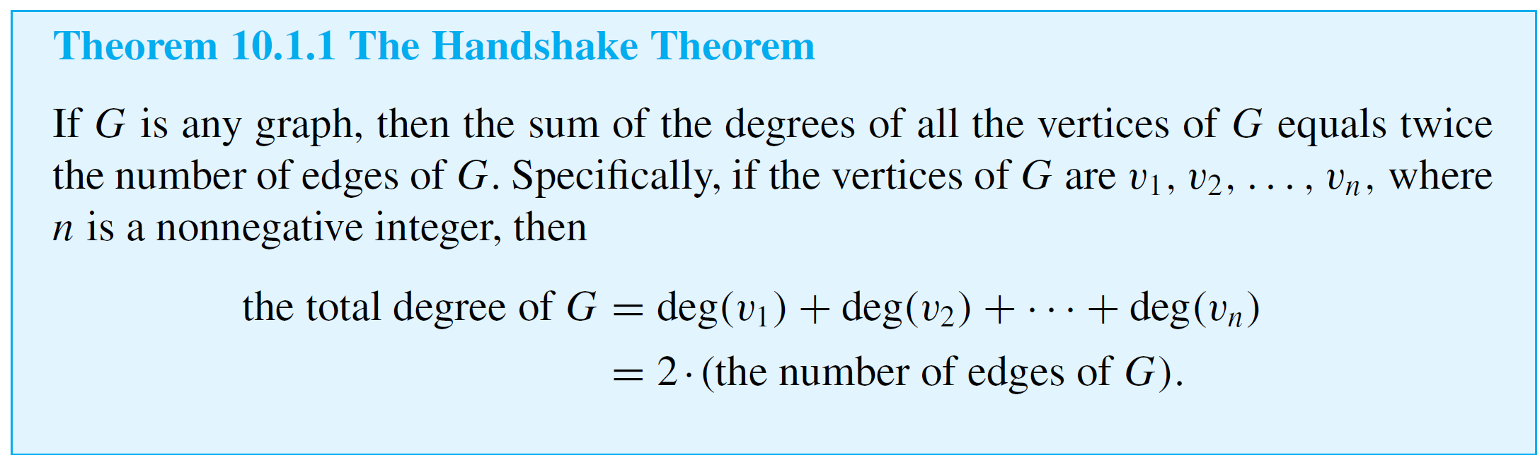
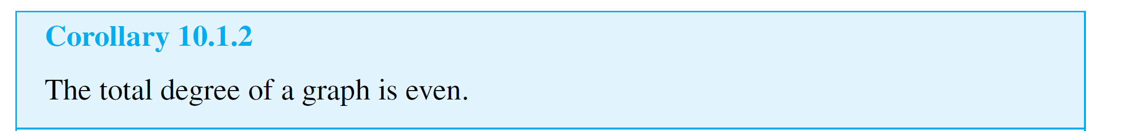
The Concept of Degree
As the proof demonstrates, the conclusion is true even if the graph contains loops.

Slide 39

The Concept of Degree
The following proposition is easily deduced from Corollary 10.1.2 using properties of even and odd integers.

